Slide 1
Unit IV: Fuel Topic: Solid fuel(Coal),
Classification of coal
Dr. P. G. Umape
PUNE INSTITUTE OF COMPUTER TECHNOLOGY

Slide 2
Solid Fuels
Learning outcomes:
Student should understand composition of coal, process of coalification.
Student should be able to decide the use of different types of coal based on their properties.

Slide 3
Solid Fuels
Coal is a highly carbonaceous material
It is a fossil fuel produced from the vegetable debris buried deep in the earth crust for over million years by the process of Coalification.
Coalification is a process of conversion of vegetable matter into coal by the action of high temperature and pressure.
It takes millions of years to form the coal by coalification process.
The time required for coalification depends on dept of burial.

Slide 4
Solid Fuels
Coal is mainly composed of carbon atom having SP² hybridisation
It is a huge molecule with indefinite number of carbon atoms
Along with carbon atom coal also consist hydrogen, oxygen, nitrogen, sulfur covalently bonded to carbon.
Coal also consist of water and minerals
The amount of water present in a coal depends on the coalification stage.
During combustion of coal, water →water vapour and
Mineral → ash (metal oxide , silica)

Slide 5
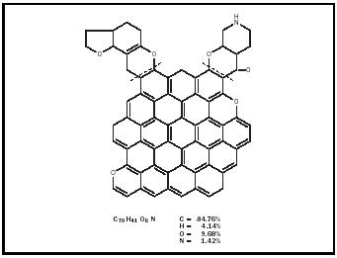
Solid Fuels
Image Source: http://www.chemistryexplained.com/Ce-Co/Coal.html

Slide 6
Solid Fuels
Types of coal (Stages/Grades/Ranks)
The classification of coal or the stages of coal depends on the extent of transformation (wood to coal).
There are four types of coal
Peat
Lignite
Bituminous
Anthracite
Carbon percentage,
Calorific value,
Density,
Luster ,
Hardness,
Black colour intensity
%Moisture
% Ash
% Volatile matter
%H
%N
%O
%S

Slide 7
Solid Fuels
Lignite
Aerobic decay
Anaerobic decay
Wood
Peat
Long
Time
Acidic Condition
Anthracite
Anaerobic decay,
Alkaline condition
Long time
Bituminous
Sub bituminous
Bituminous
Bituminous
Semi bituminous

Slide 8
Properties and applications
of Peat
Properties:
It is the first stage in coalification process
It is a brown fibrous jelly like mass
It consist of around 80-90% water
After drying it can burn freely
Average composition of air-dried peat is C=57%, H=6%, O=35% and ash = 2.5 to 6%
Calorific value of peat is about 5400 Kcal/Kg

Slide 9
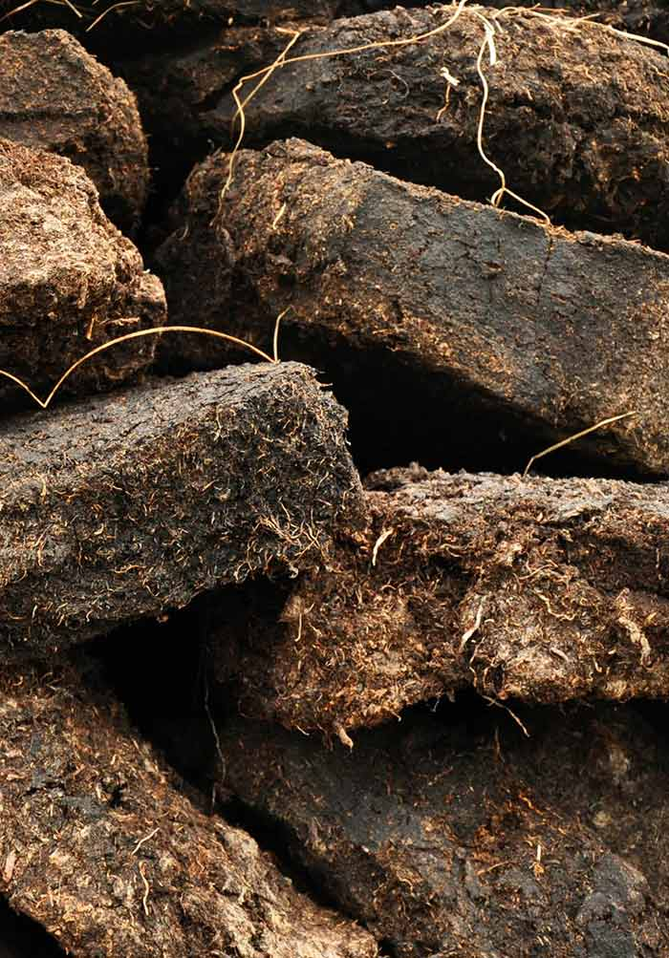
Properties and applications
of Peat
Uses:
It is used after briquetting as domestic and industrial fuel
It is used to produce char oil and light spirit on carbonisation.
It is used for thermal insulation, gas purification, steam raising

Slide 10
Properties and applications
of Lignite
Properties:
It consist of vegetable matter decomposed more than peat
It is soft brown and compact in texture
It consist of 20-60% water
On drying it breaks into small pieces
Average composition of air-dried lignite is C=60 to 70%, H=5%, 10-15% ash, O=20%
It burns with smoky flame, and calorific value is about 6500-7100 Kcal/Kg
:

Slide 11
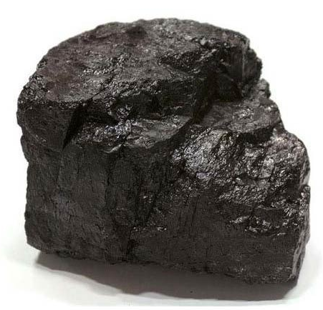
Properties and applications
of Lignite
Uses:
It can be used as domestic and industrial fuel after briquetting.
It can be used for power generation
For making producer gas
It is used for making tar by carbonisation

Slide 12
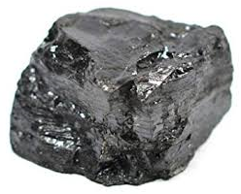
Properties and applications
of Bituminous
Properties:
It is having dark grey to pitch black colour
Burns with smoky yellow flame
It has laminated structure with alternate bright and dull layers
Bituminous contain 70-90% Carbon
Sub-bituminous:
Properties:
They are black in colour
Homogeneous and smooth in appearance
It have high volatile matter and moisture content

Slide 13
Properties and applications
of Bituminous
Sub-bituminous:
Properties:
It contains 70-83% carbon and 10-20% oxygen.
Calorific value of sub-bituminous is 7000 Kcal/Kg.
They crumbles into pieces on exposure to air
They are non-caking coal
Uses:
It is used for domestic and industrial purpose.

Slide 14
Properties and applications
of Bituminous
Bituminous:
It is hard, black and denser than sub-bituminous
They show typical banded structure
It has cubical fracture
Carbon content ranges from 78-90%
It has 20-45% volatile matter content
Calorific value is 8000 to 8500 Kcal/Kg
Uses
It is used in industry for making metallurgical coal, coal gas, steam rising and domestic heating

Slide 15
Properties and applications
of Bituminous
Semi-Bituminous:
Properties
It includes varieties of bituminous coal
They are rich in carbon 90-95%.
It has low volatile matter content
Calorific value is about 8500-8600Kcal/Kg
Uses:
Used for coke manufacture

Slide 16
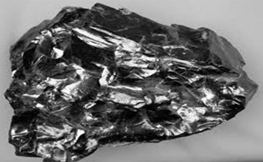
Properties and applications
of Anthracite
Properties:
It is a highest ranked coal
Contain highest percentage of carbon 92-98%
They are the hardest coal, dense and lustrous
Contain less than 8% volatile matter and 3% ash
They burn without smoke
Calorific value ranges from 8650 to 8700 Kcal/Kg
Uses:
Used for steam raising, in metallurgical process, domestic and industrial purpose

Slide 17
Summary
Coalification
Composition of coal
Types of coal
Properties and used of different types of coal

Slide 18
Thank You

